Slide 1
Introduction to Web Technology
Course Code: CSC 3215
Course Title: WEB TECHNOLOGIES
Dept. of Computer Science
Faculty of Science and Technology
Lab No: | 1 | Week No: | 1 | Semester:
Lecturer: | Md.Al-Amin (alamin@aiub.edu)

Slide 2
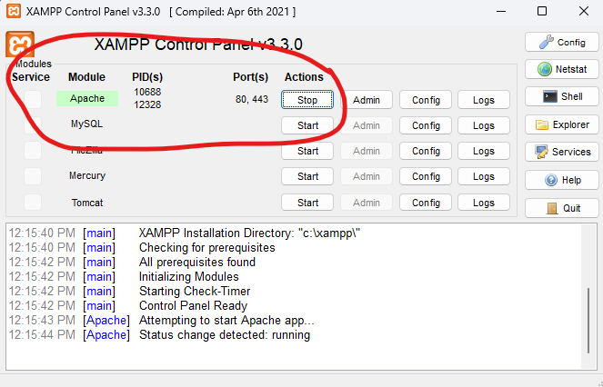
Sever Installation and Run
Download and Install XAMPP https://www.apachefriends.org/
in your PC.
Start Apache service
Open your browser and write following URL; http://localhost/dashboard/

Slide 3
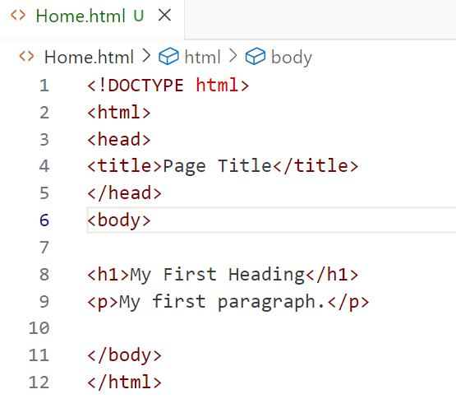
Running the first Code
Create a file name home.html in C:\xampp\htdocs and write the following
To run the code write the URL in your browser http://localhost/home.html

Slide 4
XAMPP
XAMPP is a free and open-source cross-platform web server solution stack package developed by Apache Friends
It has Apache HTTP Server, MariaDB database, and interpreters for scripts written in the PHP and Perl programming languages.
allows developers to create a local web server for testing and development purposes.

Slide 5
Apache
Apache is HTTP server software
developed by the Apache Software Foundation
It runs on multiple operating systems, including Windows, Linux, macOS,
Apache is a free and open-source
serves static files (HTML, images) and works with server-side languages (PHP, Python) to deliver dynamic web pages.

Slide 6
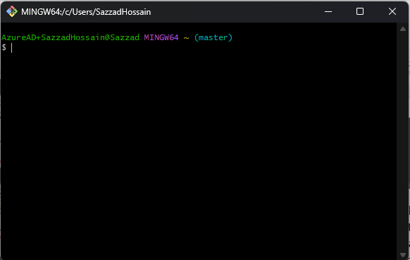
Git Bash
A command-line tool for Windows
Combines Git (version control) and Bash (Unix-like shell)
Used to manage code, track changes, and collaborate
Download from git-scm.com
Run installer, keep defaults
Enable "Git Bash Here" option
Launch Git Bash from Start menu

Slide 7
Commands
cd project-folder-directory
git config --global user.name "Your Name"
git config --global user.email "your.email@example.com"
git init
git add .
git commit -m "first commit"
git branch -M main
git remote add origin {your remote git repository}
git push -u origin main

Slide 8
Git Commands
git init initializes a new Git repository in current directory
git commit saves a snapshot of staged changes to the repository’s history. It’s saving your progress of the code or files.
git push uploads local commits to a remote repository

